Slide 1
Naan Mudhalvan
Salesforce Developer
PROJECT TITLE: Workflow Administration Solution
TEAM MEMBERS
SHRUTHIKA C (611220205034)(TEAM LEAD)
SURYA PRAKASH A (611220205040)
SURENDHIRAN K(611220205039)
GOKULNATH K (611220205302)
COURSE INSTRUCTOR
Mr.R.AYYAPPAN
COLLEGE SPOC
Mr.T.KARTHIKEYAN

Slide 2
PROJECT GOAL
The project goal for the workforce administration solution is to streamline HR processes, enhance data visibility, and improve the employee experience through the implementation of Salesforce, ultimately increasing operational efficiency and data-driven decision-making.
PROJECT DESCRIPTION
The workforce administration solution aims to automate HR tasks and improve workforce management efficiency through Salesforce, providing real-time insights and enhancing employee self-service capabilities. It focuses on optimizing administrative processes and data-driven decision-making.

Slide 3
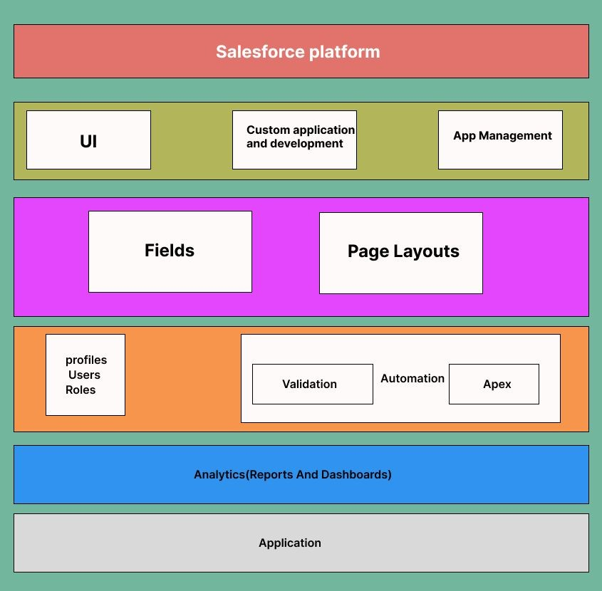
TECHNICAL ARCHITECTURE

Slide 4
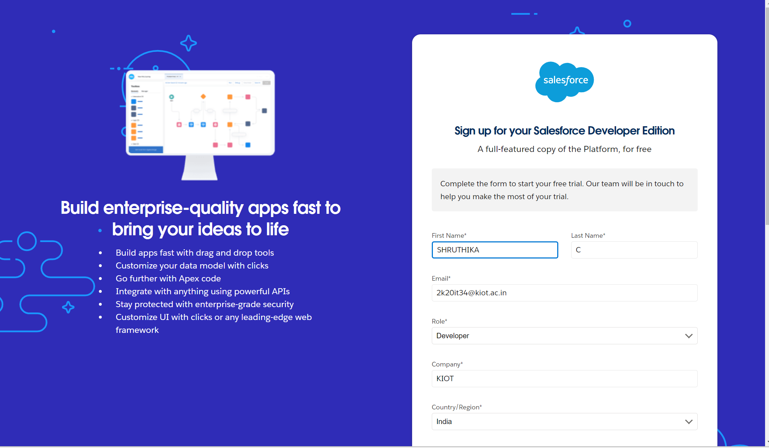
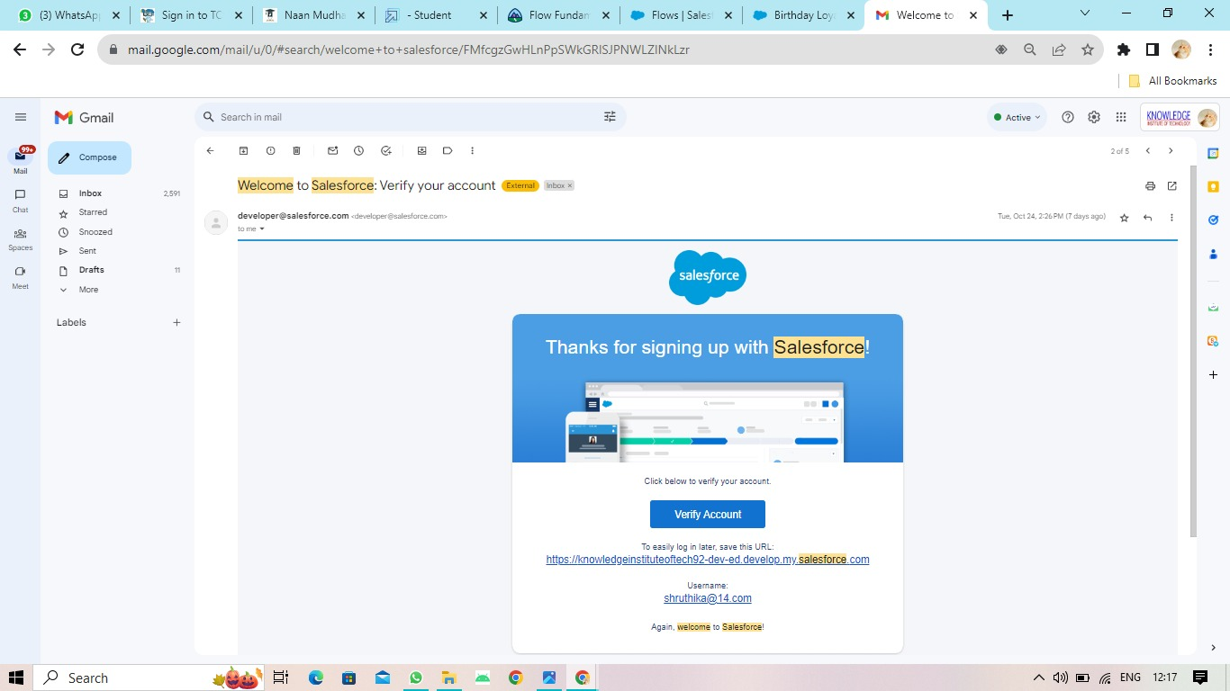
SALESFORCE DEVELOPER ORG

Slide 5
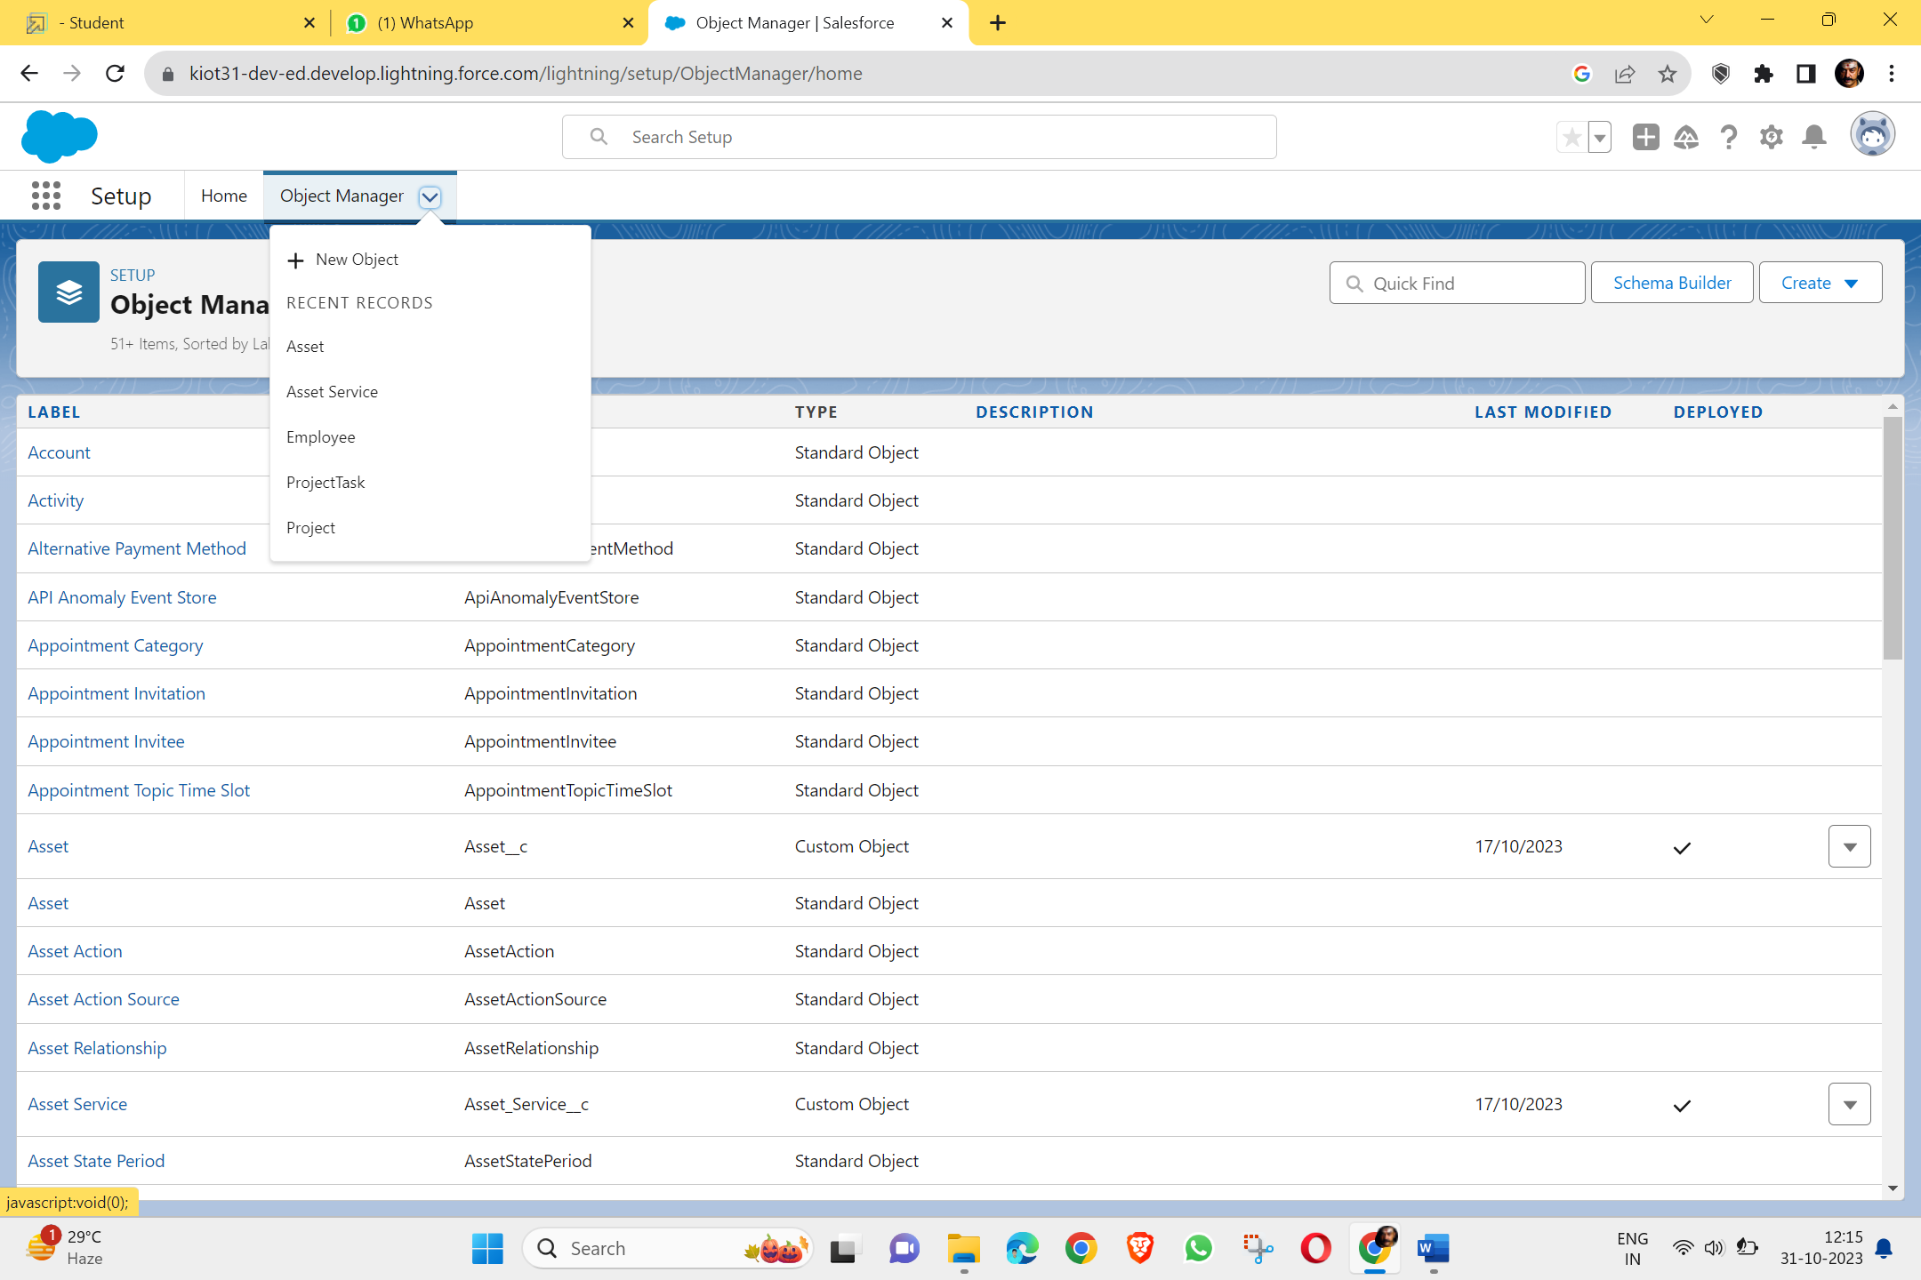
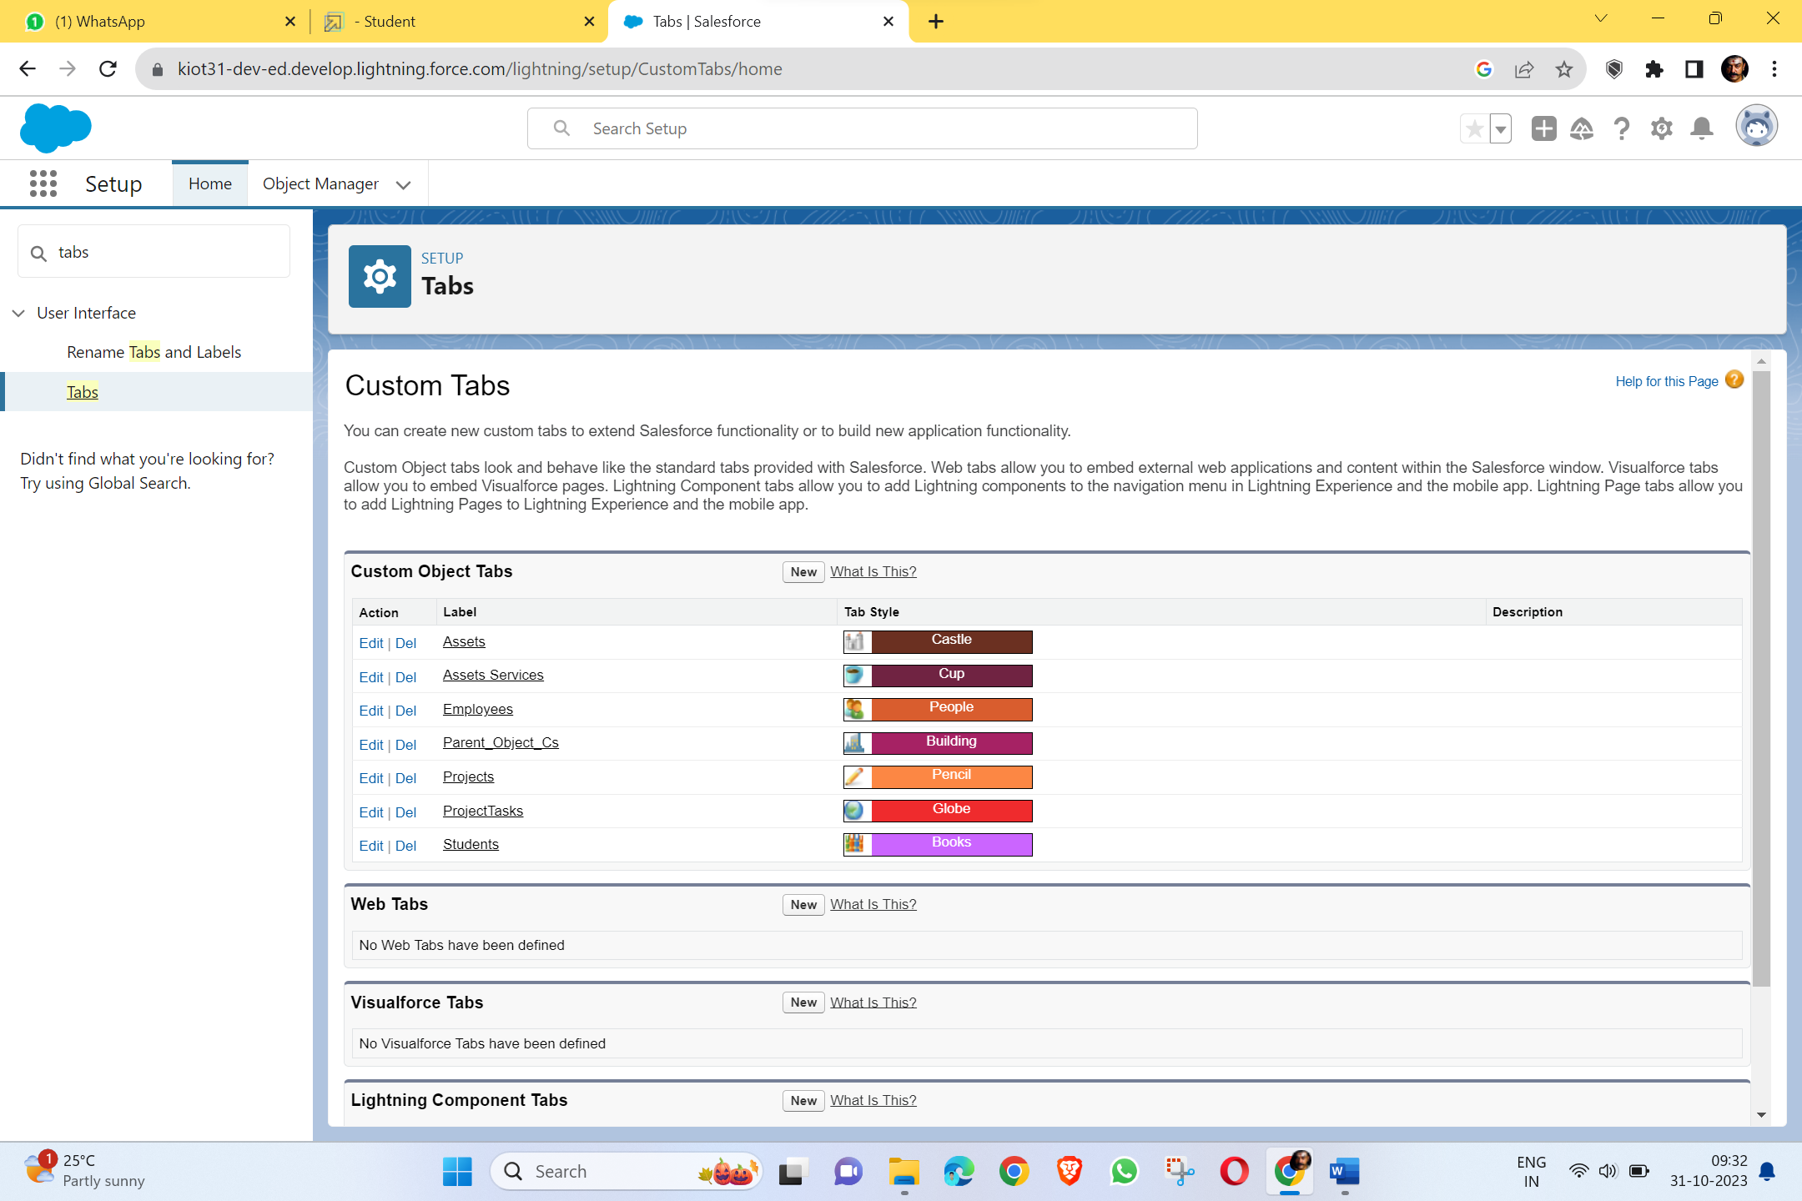
CUSTOM OBJECT CREATION & TABS

Slide 6
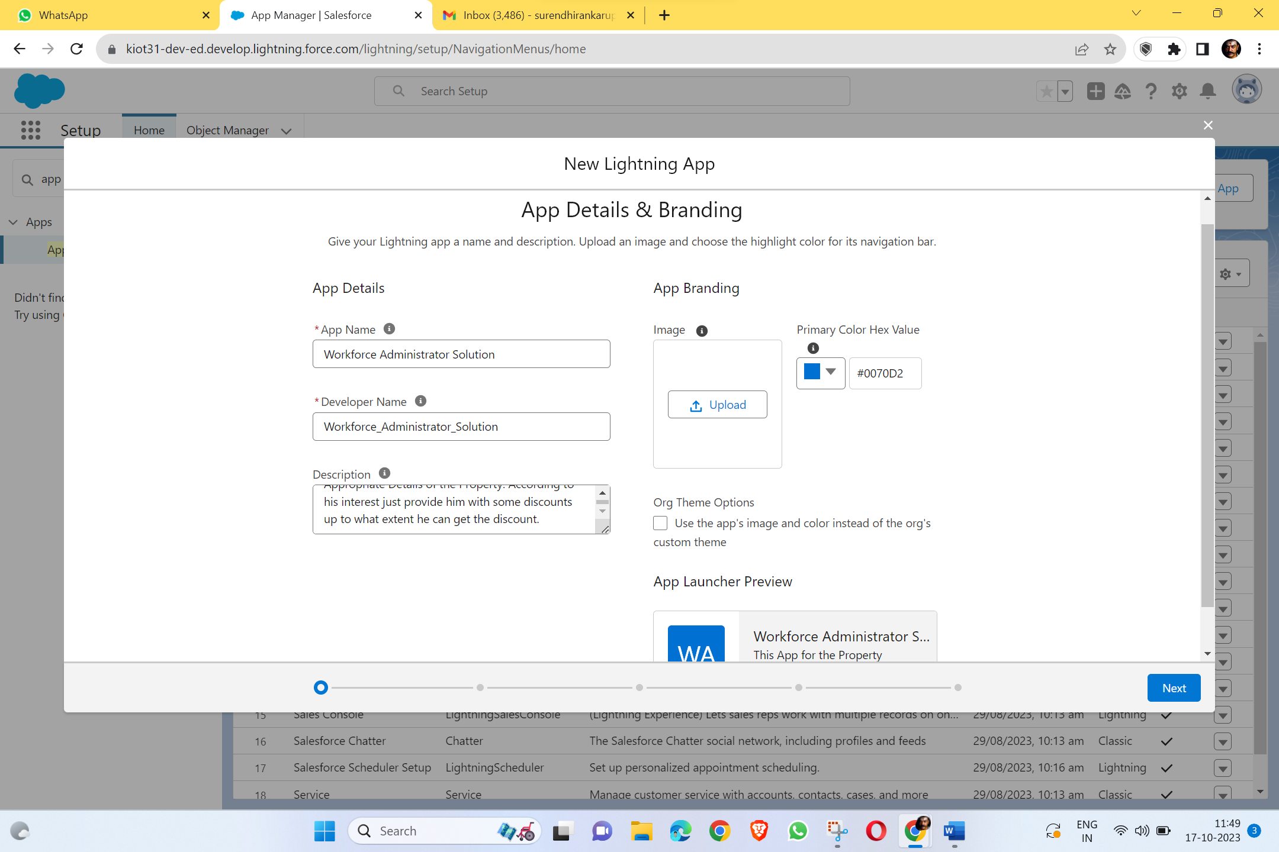
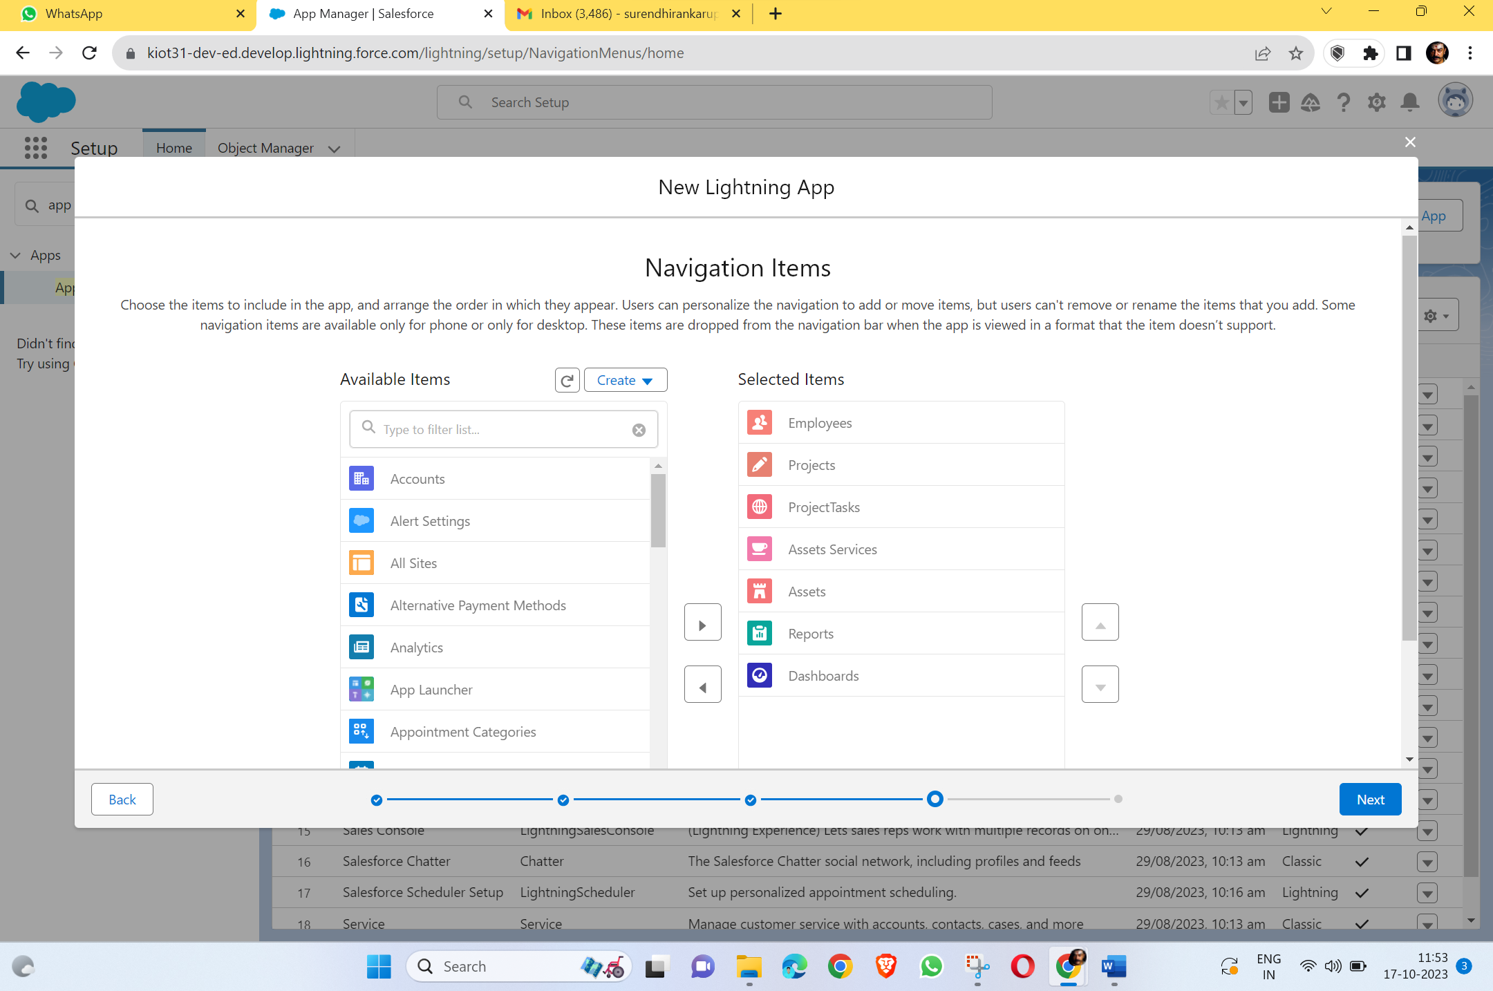
LIGHTNING APP

Slide 7
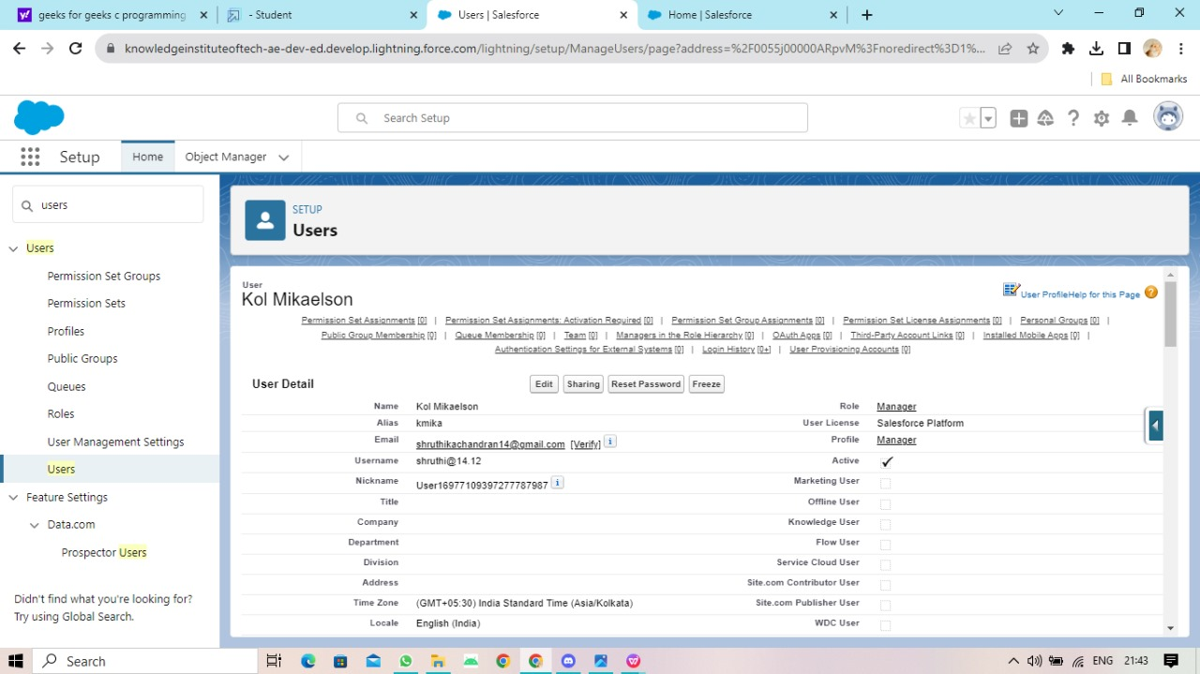
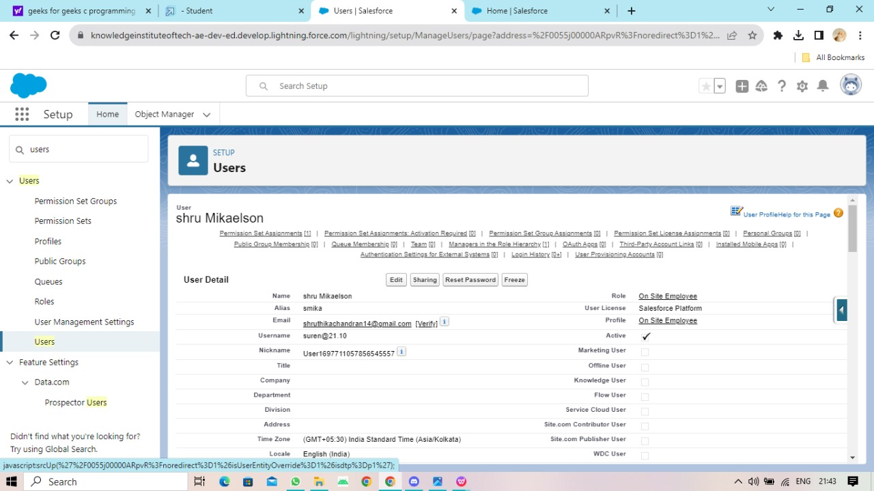
USER CREATION

Slide 8
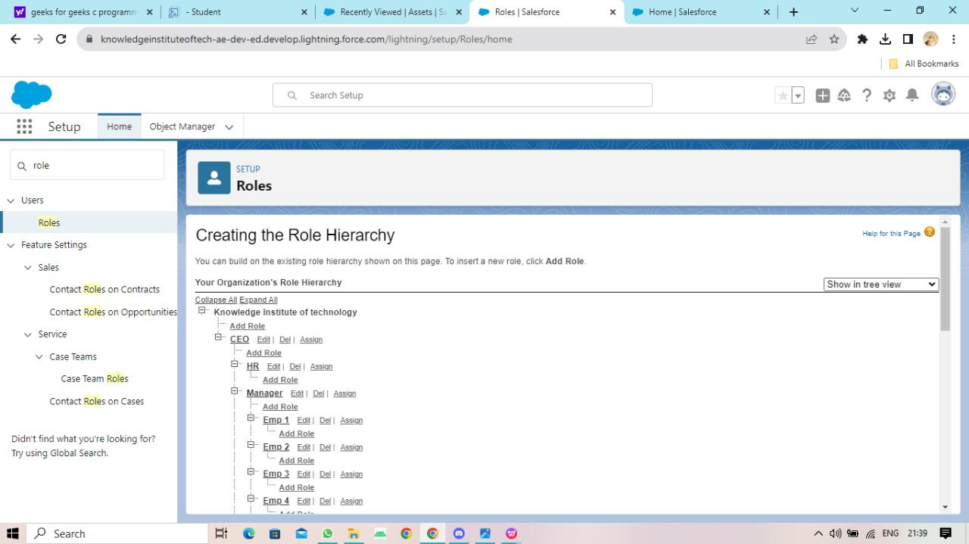
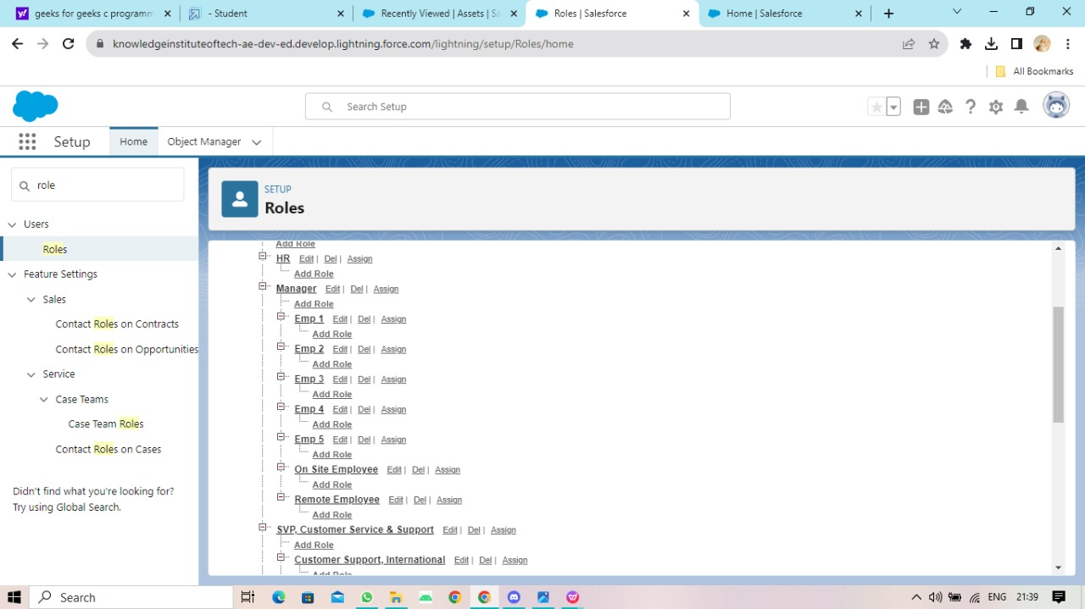
ASSIGN ROLES

Slide 9
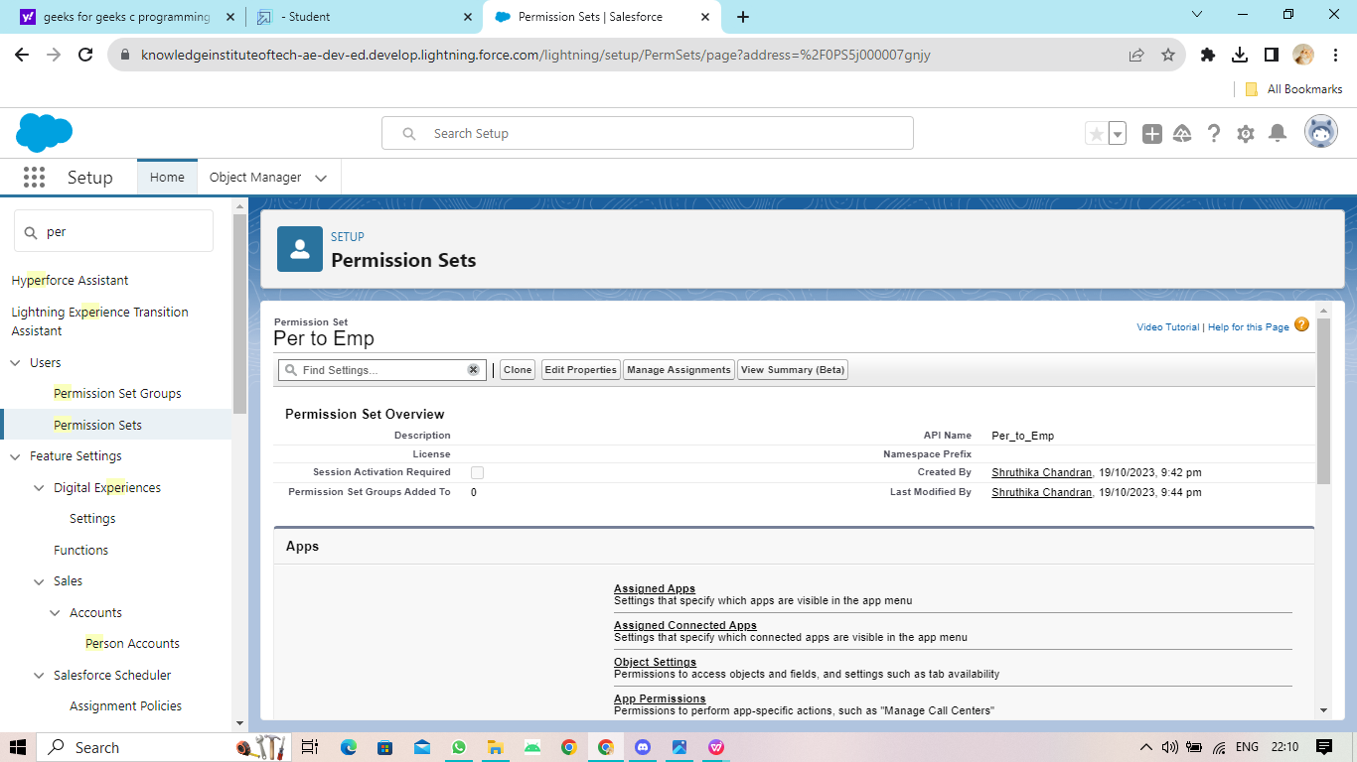
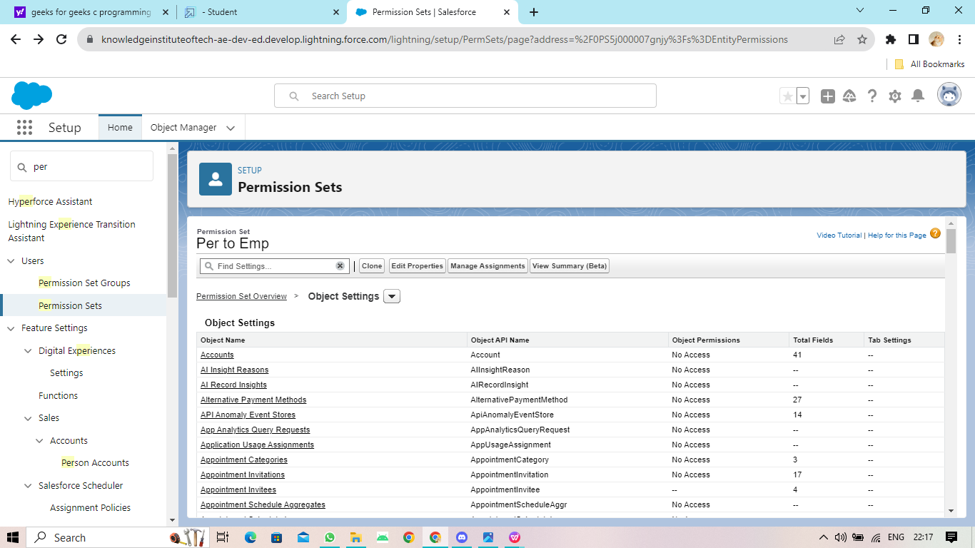
PERMISSION SETS

Slide 10
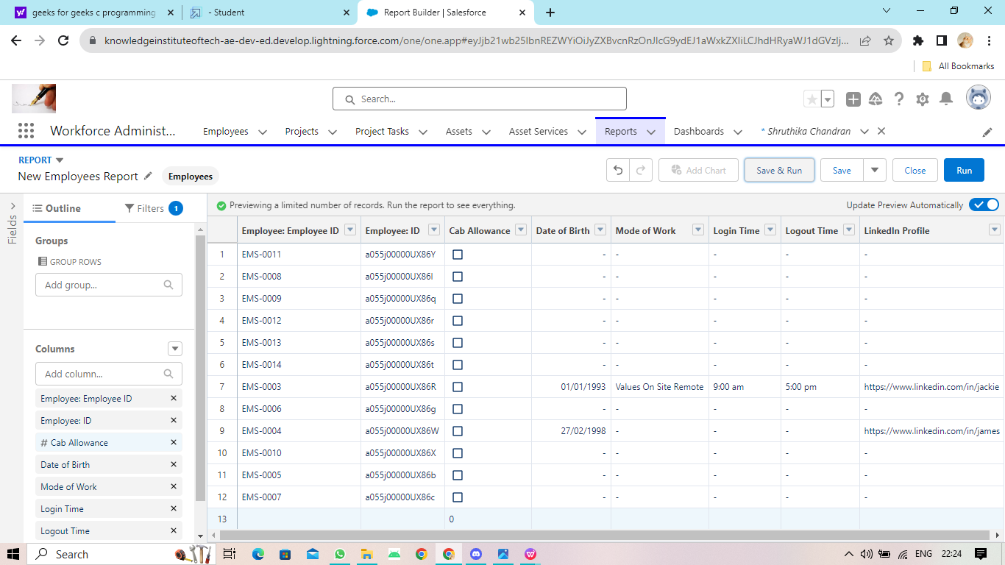
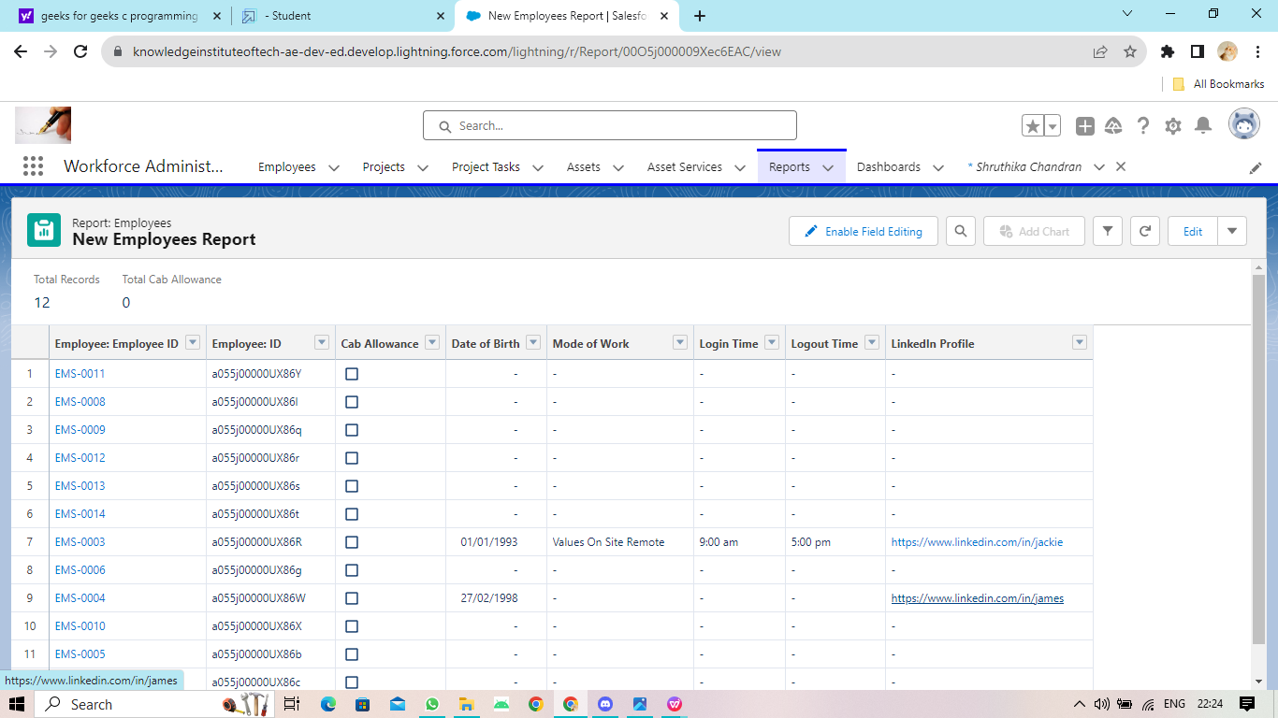
REPORTS

Slide 11
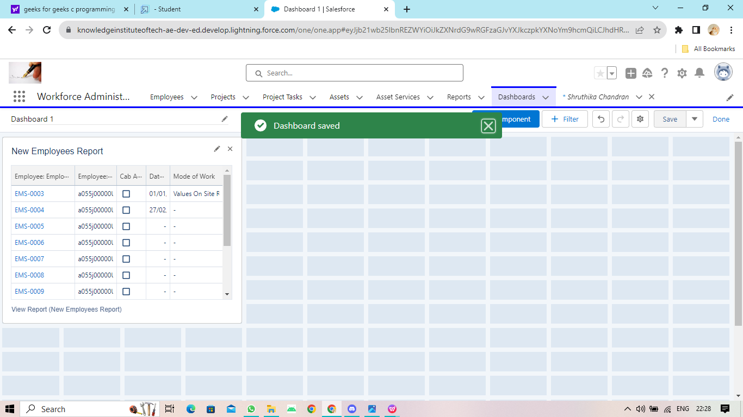
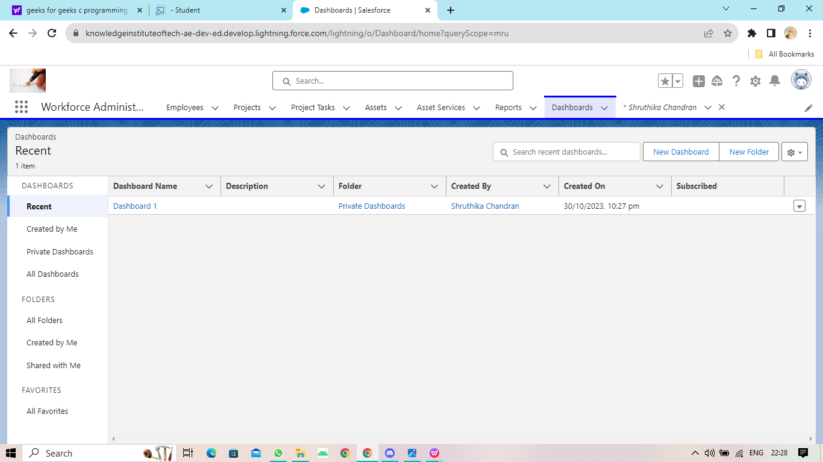
DASHBOARD

Slide 12
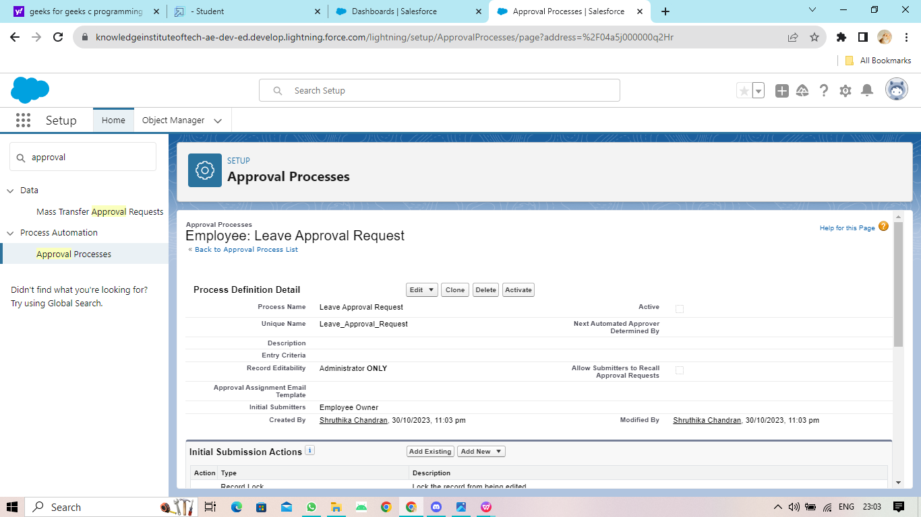
APPROVAL PROCESS

Slide 13
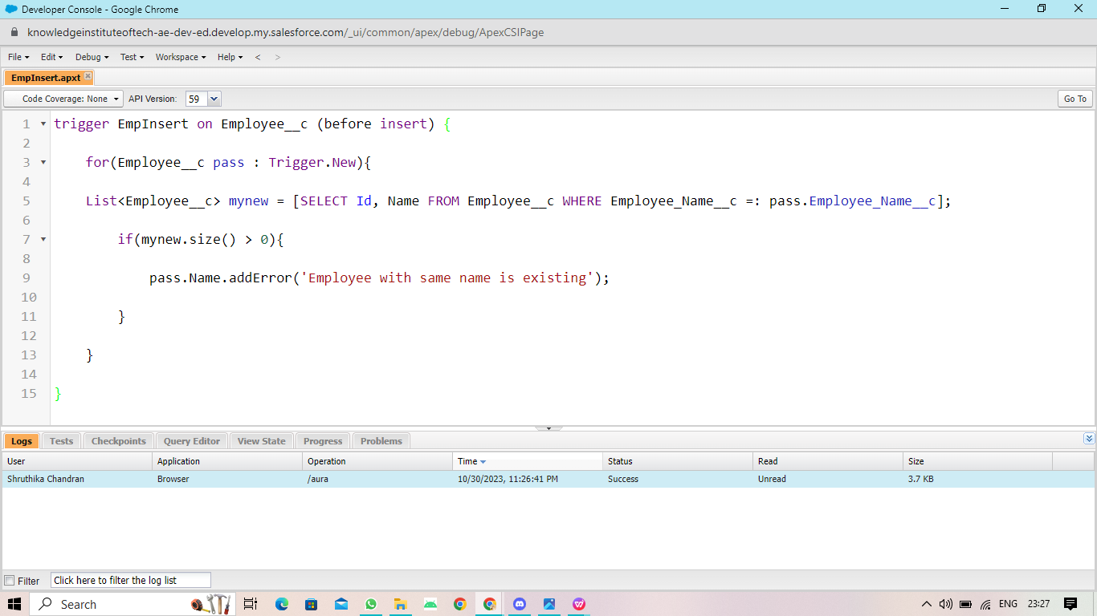
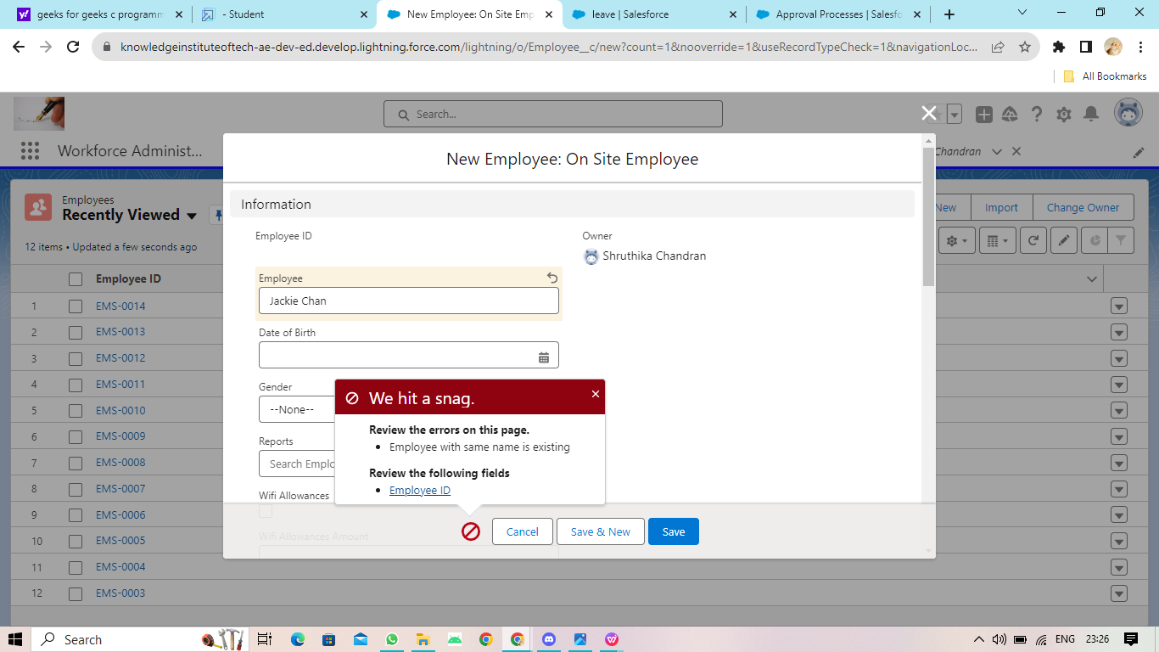
APEX TRIGGER

Slide 14
THANK YOU

